Slide 1
UNIT 2
Knowledge Representation and Logic Programming

Slide 2
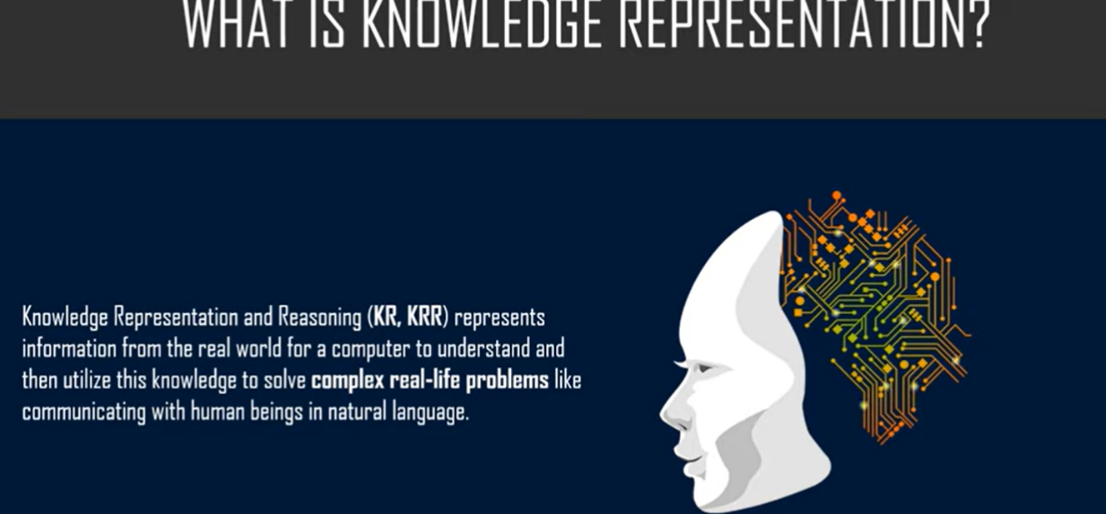

Slide 5
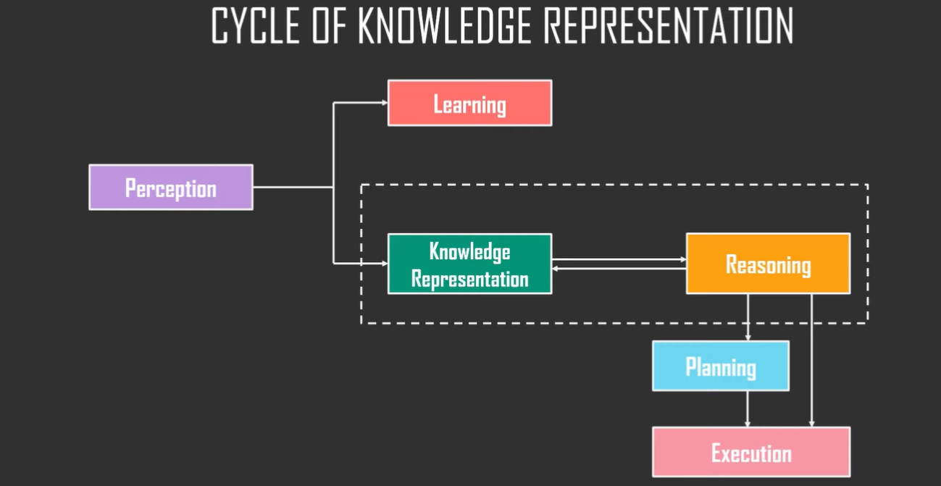

Slide 6
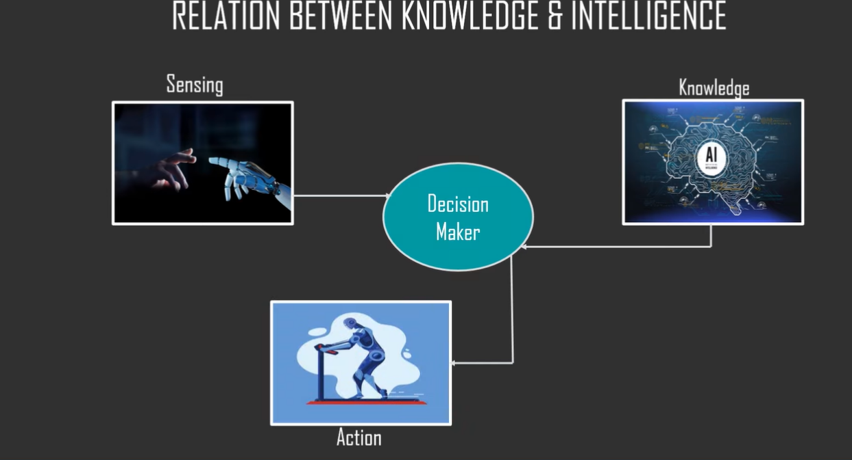

Slide 15
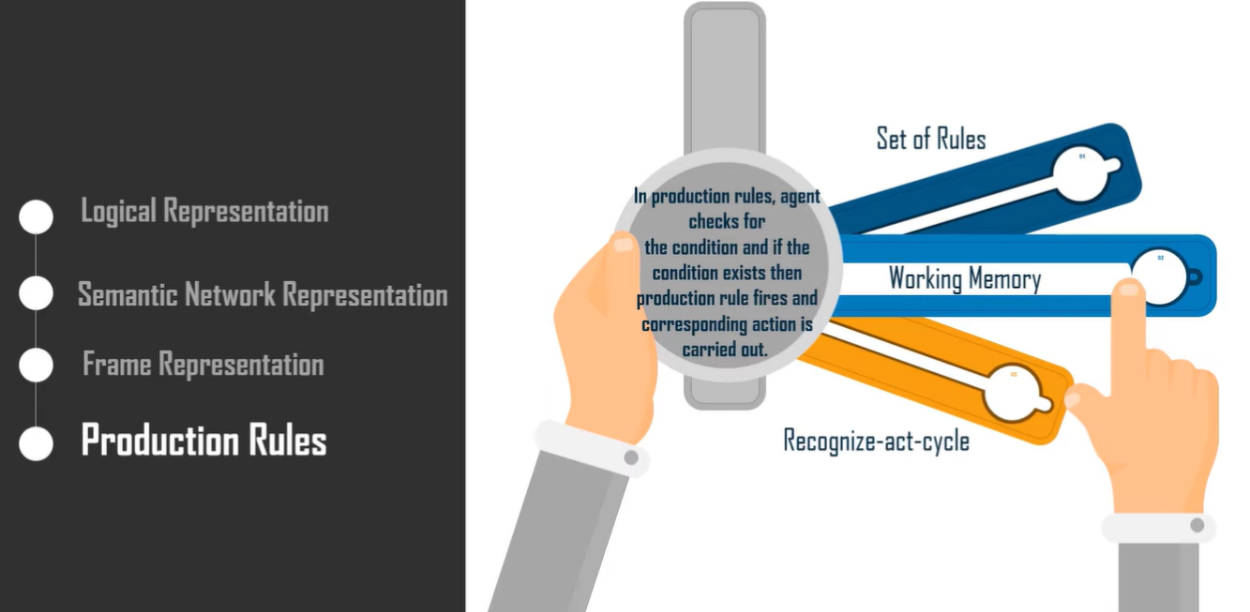

Slide 21
Knowledge-Based Agent in Artificial Intelligence
An intelligent agent needs knowledge about the real world to take decisions and reason to act efficiently.
Knowledge-based agents are those agents who have the capability of maintaining an internal state of knowledge, reason over that knowledge, update their knowledge after observations and take actions.
These agents can represent the world with some formal representation and act intelligently.
Knowledge-based agents are composed of two main parts:
Knowledge-base and
Inference system.
A knowledge-based agent must be able to do the following:
An agent should be able to represent states, actions, etc.
An agent Should be able to incorporate new percepts
An agent can update the internal representation of the world
An agent can deduce the internal representation of the world
An agent can deduce appropriate actions.

Slide 22
The architecture of knowledge-based agent

Slide 23
Why use a knowledge base?
Knowledge-base is required for updating knowledge for an agent to learn with experiences and act as per the knowledge.
Inference system
Inference means deriving new sentences from old ones.
The inference system allows us to add a new sentence to the knowledge base. A sentence is a proposition about the world. The inference system applies logical rules to the KB to deduce new information.
The inference system generates new facts so that an agent can update the KB.
An inference system works mainly in two rules which are given as:
Forward chaining
Backward chaining
Operations Performed by KBA
The following are three operations that are performed by KBA in order to show intelligent behavior:
TELL: This operation tells the knowledge base what it perceives from the environment.
ASK: This operation asks the knowledge base what action it should perform.
Perform: It performs the selected action.

Slide 24
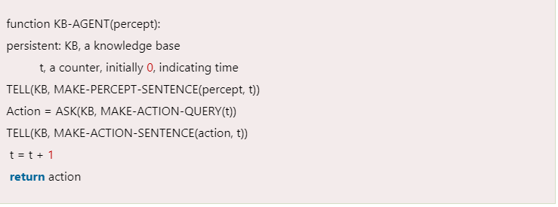
A generic knowledge-based agent
Input
Knowledge Base
Time for the whole process
Each time the function is called these three steps are performed

Slide 25
Various levels of a knowledge-based agent
A knowledge-based agent can be viewed at different levels which are given below:
1. Knowledge level
The knowledge level is the first level of knowledge-based agent, and in this level, we need to specify what the agent knows, and what the agent goals are. With these specifications, we can fix its behavior.
For example, suppose an automated taxi agent needs to go from station A to station B, and he knows the way from A to B, so this comes at the knowledge level.
2. Logical level:
At this level, we understand how the knowledge representation of knowledge is stored. At this level, sentences are encoded into different logics. At the logical level, an encoding of knowledge into logical sentences occurs.
At the logical level, we can expect the automated taxi agent to reach destination B.
3. Implementation level:
This is the physical representation of logic and knowledge. At the implementation level agent perform actions as per logical and knowledge level.
At this level, an automated taxi agent implements his knowledge and logic so that he can reach the destination.

Slide 26
Approaches to designing a knowledge-based agent:
There are mainly two approaches to building a knowledge-based agent:
Declarative approach: We can create a knowledge-based agent by initializing with an empty knowledge base and telling the agent all the sentences with which we want to start. This approach is called the Declarative approach.
2. Procedural approach: In the procedural approach, we directly encode desired behavior as a program code. This means we just need to write a program that already encodes the desired behavior or agent.
However, in the real world, a successful agent can be built by combining both declarative and procedural approaches, and declarative knowledge can often be compiled into more efficient procedural code.

Slide 27
What is knowledge representation?
Humans are best at understanding, reasoning, and interpreting knowledge. Human knows things, which is knowledge and as per their knowledge, they perform various actions in the real world.
But how machines do all these things comes under knowledge representation and reasoning. Hence, we can describe Knowledge representation as follows:
Knowledge representation and reasoning (KR, KRR) is the part of Artificial intelligence which concerned with AI agents thinking and how thinking contributes to the intelligent behavior of agents.
It is responsible for representing information about the real world so that a computer can understand and can utilize this knowledge to solve complex real-world problems such as the diagnosis of a medical condition or communicating with humans in natural language.
It is also a way that describes how we can represent knowledge in artificial intelligence.
Knowledge representation is not just storing data in some database, but it also enables an intelligent machine to learn from that knowledge and experiences so that it can behave intelligently like a human.

Slide 28
What to Represent:
Following is the kind of knowledge that needs to be represented in AI systems:
Object: All the facts about objects in our world domain. E.g., Guitars contain strings, and trumpets are brass instruments.
Events: Events are the actions that occur in our world.
Performance: It describes behavior that involves knowledge about how to do things.
Meta-knowledge: It is knowledge about what we know.
Facts: Facts are the truths about the real world and what we represent.
Knowledge-Base: The central component of the knowledge-based agents is the knowledge base.
It is represented as KB. The Knowledgebase is a group of Sentences (Here, sentences are used as a technical term and not identical to the English language).
Knowledge: Knowledge is awareness or familiarity gained by experiences of facts, data, and situations.

Slide 29
Types of knowledge

Slide 30
1. Declarative Knowledge:
Declarative knowledge is to know about something.
It includes concepts, facts, and objects.
It is also called descriptive knowledge and is expressed in declarative sentences.
It is simpler than procedural language.
2. Procedural Knowledge
It is also known as imperative knowledge.
Procedural knowledge is a type of knowledge that is responsible for knowing how to do something.
It can be directly applied to any task.
It includes rules, strategies, procedures, agendas, etc.
Procedural knowledge depends on the task on which it can be applied.

Slide 31
3. Meta Knowledge
Knowledge about the other types of knowledge is called Meta-knowledge.
4. Heuristic knowledge:
Heuristic knowledge is representing the knowledge of some experts in a field or subject.
Heuristic knowledge is rules of thumb based on previous experiences, awareness of approaches, and which are good to work but not guaranteed.
5. Structural knowledge:
Structural knowledge is basic knowledge for problem-solving.
It describes relationships between various concepts such as kind of, part of, and grouping of something.
It describes the relationship that exists between concepts or objects.

Slide 32
The relation between knowledge and intelligence

Slide 33
AI knowledge cycle

Slide 34
Requirements for knowledge Representation system:
A good knowledge representation system must possess the following properties.
1. Representational Accuracy:
KR system should have the ability to represent all kinds of required knowledge.
2. Inferential Adequacy:
KR system should have the ability to manipulate the representational structures to produce new knowledge corresponding to existing structures.
3. Inferential Efficiency:
The ability to direct the inferential knowledge mechanism in the most productive directions by storing appropriate guides.
4. Acquisitional efficiency- The ability to acquire new knowledge easily using automatic methods.

Slide 35
Techniques of knowledge representation

Slide 36
1. Logical Representation
Logical representation is a language with some concrete rules which deal with propositions and has no ambiguity in representation.
Logical representation means drawing a conclusion based on various conditions.
This representation lays down some important communication rules.
It consists of precisely defined syntax and semantics which supports sound inference. Each sentence can be translated into logic using syntax and semantics.
Syntax:
Syntaxes are the rules which decide how we can construct legal sentences in logic.
It determines which symbol we can use in knowledge representation.
How to write those symbols.
Semantics:
Semantics are the rules by which we can interpret the sentence in logic.
Semantics also involves assigning a meaning to each sentence.
Logical representation can be categorized into mainly two logics: Propositional Logic, Predicate logic

Slide 37
Advantages of logical representation:
Logical representation enables us to do logical reasoning.
Logical representation is the basis for programming languages.
Disadvantages of logical Representation:
Logical representations have some restrictions and are challenging to work with.
Logical representation techniques may not be very natural, and inference may not be so efficient.

Slide 38
2. Semantic Network Representation
Semantic networks are an alternative to predicate logic for knowledge representation.
In Semantic networks, we can represent our knowledge in the form of graphical networks.
This network consists of nodes representing objects and arcs which describe the relationship between those objects. Semantic networks can categorize the object in different forms and can also link those objects. Semantic networks are easy to understand and can be easily extended.
This representation consists of mainly two types of relations:
IS-A relation (Inheritance)
Kind-of-relation
Example: Following are some statements that we need to represent in the form of nodes and arcs.
Statements:
Jerry is a cat. Jerry is a mammal Jerry is owned by Priya.
Jerry is brown-colored. All Mammals are animals.

Slide 40
Drawbacks in Semantic representation:
Semantic networks take more computational time at runtime as we need to traverse the complete network tree to answer some questions.
It might be possible in the worst-case scenario that after traversing the entire tree, we find that the solution does not exist in this network.
Semantic networks try to model human-like memory (Which has 1015 neurons and links) to store the information, but in practice, it is not possible to build such a vast semantic network.
These types of representations are inadequate as they do not have any equivalent quantifier, e.g., for all, for some, none, etc.
Semantic networks do not have any standard definition for the link names.
These networks are not intelligent and depend on the creator of the system.
Advantages of Semantic network:
Semantic networks are a natural representation of knowledge.
Semantic networks convey meaning in a transparent manner.
These networks are simple and easily understandable.

Slide 41
3. Frame Representation
A frame is a record-like structure that consists of a collection of attributes and their values to describe an entity in the world. Frames are the AI data structure that divides knowledge into substructures by representing stereotypical situations.
It consists of a collection of slots and slot values.
These slots may be of any type and size.
Slots have names and values which are called facets.
Facets: The various aspects of a slot are known as Facets. Facets are features of frames that enable us to put constraints on the frames.
Example: IF-NEEDED facts are called when data of any slot is needed.
A frame may consist of any number of slots, and a slot may include any number of facets and facets may have any number of values.
A frame is also known as slot-filter knowledge representation in artificial intelligence.
Frames are derived from semantic networks and later evolved into our modern-day classes and objects.

Slide 42
In the frame, knowledge about an object or event can be stored together in the knowledge base.
The frame is a type of technology that is widely used in various applications including Natural language processing and machine visions.
Example of a frame for a book

Slide 43
Advantages of frame representation:
The frame knowledge representation makes the programming easier by grouping the related data.
The frame representation is comparably flexible and used by many applications in AI.
It is very easy to add slots for new attributes and relations.
It is easy to include default data and search for missing values.
Frame representation is easy to understand and visualize.
Disadvantages of frame representation:
In the frame system, the inference mechanism is not easily processed.
The inference mechanism cannot be smoothly proceeded by frame representation.
Frame representation has a much more generalized approach.

Slide 44
4. Production Rules
Production rules system consists of (condition, action) pairs which mean, "If condition then action". It has mainly three parts:
The set of production rules
Working Memory
The recognize-act-cycle
In production rules, the agent checks for the condition and if the condition exists then the production rule fires, and corresponding action is carried out.
The condition part of the rule determines which rule may be applied to a problem.
And the action part carries out the associated problem-solving steps.
This complete process is called a recognize-act cycle.
The working memory contains the description of the current state of problem-solving and the rule can write knowledge to the working memory. This knowledge match and may fire other rules.
If there is a new situation (state) generated, then multiple production rules will be fired together, this is called a conflict set.
In this situation, the agent needs to select a rule from these sets, and it is called conflict resolution.

Slide 45
Advantages of Production rule:
The production rules are expressed in natural language.
The production rules are highly modular, so we can easily remove, add or modify an individual rule.
Disadvantages of Production rule:
The production rule system does not exhibit any learning capabilities, as it does not store the result of the problem for future use.
During the execution of the program, many rules may be active hence rule-based production systems are inefficient.

Slide 46
Logic Programming: Introduction
Logic programming is a type of programming in which programmers define the rules of the program in the form of logical statements.
Concept
Logic Programming is the combination of two words, logic and programming.
Logic Programming is a programming paradigm in which the problems are expressed as facts and rules by program statements but within a system of formal logic.
Just like other programming paradigms like object-oriented, functional, declarative, procedural, etc., it is also a particular way to approach programming.

Slide 47
How to Solve Problems with Logic Programming?
Logic Programming uses facts and rules for solving the problem. That is why they are called the building blocks of Logic Programming.
A goal needs to be specified for every program in logic programming. To understand how a problem can be solved in logic programming, we need to know about the building blocks − Facts and Rules −
Facts
Every logic program needs facts to work with so that it can achieve the given goal. Facts basically are true statements about the program and data. For example, Delhi is the capital of India.
Rules
Rules are the constraints that allow us to make conclusions about the problem domain.
Rules are basically written as logical clauses to express various facts. For example, if we are building any game then all the rules must be defined.
Rules are very important to solve any problem in Logic Programming. Rules are basically logical conclusions which can express the facts.

Slide 48
Following is the syntax of the rule −
A∶− B1,B2,...,Bn.
Here, A is the head, and B1, B2, ... Bn is the body.
For example − ancestor(X,Y) :- father(X,Y).
ancestor(X,Z) :- father(X,Y), ancestor(Y,Z).
This can be read as, for every X and Y, if X is the father of Y and Y is an ancestor of Z, X is the ancestor of Z. For every X and Y, X is the ancestor of Z if X is the father of Y and Y is an ancestor of Z.

Slide 49
Installing Useful Packages
For starting logic programming in Python, we need to install the following two packages −
Kanren
It provides us a way to simplify the way we made code for business logic. It lets us express logic in terms of rules and facts. The following command will help you install kanren −
pip install kanren
SymPy
SymPy is a Python library for symbolic mathematics. It aims to become a full-featured computer algebra system (CAS) while keeping the code as simple as possible in order to be comprehensible and easily extensible. The following command will help you install SymPy −
pip install sympy

Slide 50
Examples of Logic Programming
The following are some examples that can be solved by logic programming −
Matching mathematical expressions
We can find unknown values by using logic programming in a very effective way. The following Python code will help you match a mathematical expression −
Consider importing the following packages first −
It is compulsory to define variables; this can be done as follows −

Slide 51
The first output represents the values for a and b. The first expression matched the original pattern and returned the values for a and b, but the second expression did not match the original pattern hence nothing has been returned.

Slide 52
Difference between logic programming and other AI programming paradigms
Logic programming is based on a declarative programming paradigm, meaning that the programmer declares what the program should do, rather than how it should do it.
This makes logic programming programs more human-readable and easier to understand.
Logic programming is based on formal logic, whereas other AI programming paradigms are not i.e., logic programming programs can take advantage of the many powerful inference algorithms and hence is helpful for solving complex problems.
Logic programming is a non-procedural paradigm, meaning that programs are not written as a sequence of instructions to be executed thus more flexible and easier to change. It also makes them more resistant to errors, since there is no need to worry about the order in which instructions are executed.

Slide 53
Benefits of using logic programming in AI applications
It allows for the concise representation of knowledge and the efficient execution of inference.
Logic programming has been used in various AI applications, including natural language processing, knowledge representation, reasoning, planning, and machine learning.
Logic programs are declarative, meaning they specify what is to be done, rather than how it should be done. This makes them easier to understand and maintain than procedural programs.
Logic programs can be easily extended and modified.
Logic programming is well suited for distributed systems, such as the World Wide Web.

Slide 54
Challenges associated with logic programming
It is very difficult to scale because the number of rules that need to be considered grows exponentially as the size of the problem increases. This can make it very difficult to solve large problems with logic programming.
It is difficult to deal with uncertain information. This is because the rules that are used to infer new information are based on a set of assumptions that may not be true in all cases. This can lead to incorrect results if the assumptions are not valid.
Most popular applications of logic programming
Logic programming is a type of programming that is based on formal logic.
In AI, logic programming is used for knowledge representation and reasoning. Logic programming can be used for planning, natural language processing, and other tasks.

Slide 55
Propositional logic in Artificial intelligence
Propositional logic (PL) is the simplest form of logic where all the statements are made by propositions. A proposition is a declarative statement that is either true or false.
It is a technique of knowledge representation in logical and mathematical form.
Example:
a) It is Sunday.
b) The Sun rises from the West (False proposition)
c) 3+3= 7(False proposition)
d) 5 is a prime number.

Slide 56
Basic facts about propositional logic
Propositional logic is also called Boolean logic as it works on 0 and 1.
In propositional logic, we use symbolic variables to represent the logic, and we can use any symbol to represent a proposition, such as A, B, C, P, Q, R, etc.
Propositions can be either true or false, but they cannot be both.
Propositional logic consists of an object, relations or functions, and logical connectives.
These connectives are also called logical operators.
The propositions and connectives are the basic elements of propositional logic.
Connectives can be said as a logical operator which connects two sentences.
A proposition formula that is always true is called tautology, and it is also called a valid sentence.
A proposition formula that is always false is called Contradiction.
A proposition formula that has both true and false values is called a Contingency.
Statements that are questions, commands, or opinions are not propositions such as "Where is Rohini", "How are you", and "What is your name", are not propositions.

Slide 57
Syntax of propositional logic
Atomic Propositions
Compound propositions
Atomic Proposition: Atomic propositions are simple propositions. It consists of a single proposition symbol. These are the sentences which must be either true or false.
Example:
2+2 is 4, it is an atomic proposition as it is a true fact.
b) "The Sun is cold" is also a proposition as it is a false fact.

Slide 58
Compound proposition: Compound propositions are constructed by combining simpler or atomic propositions, using parenthesis and logical connectives.
Example:
a) "It is raining today, and the street is wet."
b) "Ankit is a doctor, and his clinic is in Mumbai."
Logical Connectives:
Logical connectives are used to connect two simpler propositions or represent a sentence logically.
We can create compound propositions with the help of logical connectives.
There are mainly five connectives, which are given as follows:
Negation: A sentence such as ¬ P is called the negation of P.
A literal can be either Positive literal or negative literal.
2. Conjunction: A sentence that has ∧ a connective such as, P ∧ Q is called a conjunction.
Example: Rohan is intelligent and hardworking. It can be written as, P= Rohan is intelligent, Q= Rohan is hardworking. → P∧ Q.

Slide 59
3. Disjunction: A sentence that has ∨ a connective, such as P ∨ Q. is called disjunction, where P and Q are the propositions. Example: "Ritika is a doctor or Engineer", Here P= Ritika is Doctor. Q= Ritika is Doctor, so we can write it as P ∨ Q.
4. Implication: A sentence such as P → Q, is called an implication. Implications are also known as if-then rules. It can be represented as If it is raining, then the street is wet.
Let P= It is raining, and Q= Street is wet, so it is represented as P → Q
5. Biconditional: A sentence such as P⇔ Q is a Biconditional sentence,
example If I am breathing, then I am alive P= I am breathing, Q= I am alive, it can be represented as P ⇔ Q.

Slide 63
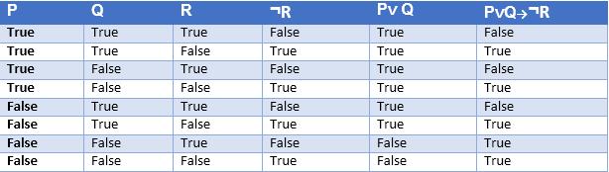
Truth table with three propositions:
It is possible to build a proposition composing three propositions P, Q, and R.
This truth table is made-up of 8n Tuples as we have taken three proposition symbols.

Slide 64
Precedence of connectives

Slide 65
Logical equivalence
Logical equivalence is one of the features of propositional logic. Two propositions are said to be logically equivalent if and only if the columns in the truth table are identical to each other.

Slide 66
Properties of Operators:
Commutativity:
P∧ Q= Q ∧ P, or
P ∨ Q = Q ∨ P.
Associativity:
(P ∧ Q) ∧ R= P ∧ (Q ∧ R),
(P ∨ Q) ∨ R= P ∨ (Q ∨ R)
Identity element:
P ∧ True = P,
P ∨ True= True.
Distributive:
P∧ (Q ∨ R) = (P ∧ Q) ∨ (P ∧ R).
P ∨ (Q ∧ R) = (P ∨ Q) ∧ (P ∨ R).
DE Morgan's Law:
¬ (P ∧ Q) = (¬P) ∨ (¬Q)
¬ (P ∨ Q) = (¬ P) ∧ (¬Q).
Double-negation elimination:
¬ (¬P) = P.

Slide 67
Limitations of Propositional Logic
We cannot represent relations like ALL, some, or none with propositional logic.
Example
All the girls are intelligent.
Some apples are sweet.
Propositional logic has limited expressive power.
In propositional logic, we cannot describe statements in terms of their properties or logical relationships.

Slide 68
Rules of Inference in Artificial Intelligence
Inference:
In artificial intelligence, we need intelligent computers which can create new logic from old logic or by evidence, so generating conclusions from evidence and facts is termed as Inference.
Inference rules:
Inference rules are the templates for generating valid arguments. Inference rules are applied to derive proofs in artificial intelligence, and the proof is a sequence of the conclusion that leads to the desired goal.
In inference rules, the implication among all the connectives plays an important role.
Following are some terminologies related to inference rules:
Implication: It is one of the logical connectives which can be represented as P → Q. It is a Boolean expression.
Converse: The converse of implication, which means the right-hand side proposition goes to the left-hand side and vice-versa. It can be written as Q → P.
Contrapositive: The negation of the converse is termed as contrapositive, and it can be represented as ¬ Q → ¬ P.
Inverse: The negation of implication is called inverse. It can be represented as ¬ P → ¬ Q.

Slide 69
Some of the compound statements are equivalent to each other, which we can prove using the truth table:
Hence from the above truth table, we can prove that P → Q is equivalent to ¬ Q → ¬ P, and Q→ P is equivalent to ¬ P → ¬ Q.

Slide 70
Types of Inference rules:
1. Modus Ponens:
The Modus Ponens rule is one of the most important rules of inference, and it states that if P and P → Q is true, then we can infer that Q will be true. It can be represented as:
Example:
Statement-1: "If I am sleepy then I go to bed" ==> P→ Q
Statement-2: "I am sleepy" ==> P
Conclusion: "I go to bed." ==> Q.
Hence, we can say that, if P→ Q is true, and P is true then Q will be true.
Proof by Truth table:

Slide 71
Modus Tollens:
The Modus Tollens rule state that if P→ Q is true and ¬ Q is true, then ¬ P will also be true. It can be represented as:
Statement-1: "If I am sleepy then I go to bed" ==> P→ Q
Statement-2: "I do not go to bed."==> ~Q
Statement-3: Which infers that "I am not sleepy" => ~P
Proof by Truth table:

Slide 72
Hypothetical Syllogism:
The Hypothetical Syllogism rule state that if P→R is true whenever P→Q is true, and Q→R is true.
It can be represented as the following notation:
Example:
Statement-1: If you have my home key then you can unlock my home. P→Q
Statement-2: If you can unlock my home then you can take my money. Q→R
Conclusion: If you have my home key then you can take my money. P→R
Proof by truth table:

Slide 73
Disjunctive Syllogism:
The Disjunctive syllogism rule state that if P∨Q is true, and ¬P is true, then Q will be true. It can be represented as:
Example:
Statement-1: Today is Sunday or Monday. ==>P∨Q
Statement-2: Today is not Sunday. ==> ¬P
Conclusion: Today is Monday. ==> Q
Proof by truth-table:

Slide 74
Addition:
The Addition rule is one of the common inference rules, and it states that If P is true, then P∨Q will be true.
Example:
Statement: I have a vanilla ice cream. ==> P
Statement-2: I have Chocolate ice cream.
Conclusion: I have vanilla or chocolate ice cream. ==> (P∨Q)
Proof by Truth Table:

Slide 75
Simplification:
The simplification rule state that if P∧ Q is true, then Q or P will also be true. It can be represented as:

Slide 76
Resolution:
The Resolution rule state that if P∨Q and ¬ P∧R is true, then Q∨R will also be true. It can be represented as
Proof by Truth Table:

Slide 77
The Wumpus World in Artificial Intelligence
The Wumpus world is a simple example to illustrate the worth of a knowledge-based agent and represent knowledge representation. It was inspired by the video game Hunt the Wumpus by Gregory Yob in 1973.
The Wumpus world is a cave that has 4/4 rooms connected with passageways. So, there are a total of 16 rooms that are associated with each other. We have a knowledge-based agent who will go forward in this world. The cave has a room with a beast which is called Wumpus, who eats anyone who enters the room. The agent can shoot the Wumpus, but the agent has a single arrow. In the Wumpus world, there are some Pits rooms that are bottomless, and if the agent falls into Pits, then he will be stuck there forever. The exciting thing with this cave is that in one room there is a possibility of finding a heap of gold. So, the agent’s goal is to find the gold and climb out of the cave without falling into Pits or being eaten by Wumpus. The agent will get a reward if he comes out with gold, and he will get a penalty if eaten by Wumpus or falls into the pit.

Slide 78
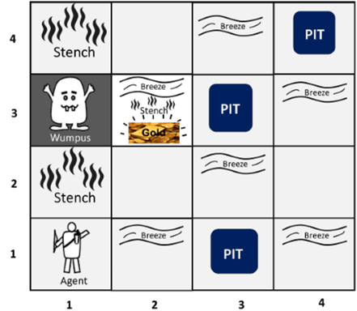
Following is a sample diagram for representing the Wumpus world. It is showing some rooms with Pits, one room with Wumpus, and one agent at (1, 1) square location of the world.

Slide 79
There are also some components that can help the agent to navigate the cave. These components are given as follows:
The rooms adjacent to the Wumpus room are smelly so it would have some stench.
The room adjacent to PITs has a breeze, so if the agent reaches near PIT, then he will perceive the breeze.
There will be glitter in the room if and only if the room has gold.
The Wumpus can be killed by the agent if the agent is facing it, and Wumpus will emit a horrible scream which can be heard anywhere in the cave.

Slide 80
PEAS description of Wumpus world:
To explain the Wumpus world we have given PEAS description as below:
Performance measure:
+1000 reward points if the agent comes out of the cave with the gold.
-1000 points penalty for being eaten by the Wumpus or falling into the pit.
-1 for each action, and -10 for using an arrow.
The game ends if either agent dies or came out of the cave.
Environment:
A 4*4 grid of rooms.
The agent is initially in room square [1, 1], facing toward the right.
The location of Wumpus and gold are chosen randomly except the first square [1,1].
Each square of the cave can be a pit with a probability of 0.2 except the first square.
Actuators:
Left turn,
Right turn
Move forward
Grab
Release
Shoot.

Slide 81
Sensors:
The agent will perceive the stench if he is in the room adjacent to the Wumpus. (Not diagonally).
The agent will perceive a breeze if he is in the room directly adjacent to the Pit.
The agent will perceive the glitter in the room where the gold is present.
The agent will perceive the bump if he walks into a wall.
When the Wumpus is shot, it emits a horrible scream which can be perceived anywhere in the cave.
These percepts can be represented as five element list, in which we will have different indicators for each sensor.
For example, if the agent perceives stench or breeze, but no glitter, no bump, and no scream then it can be represented as:
[Stench, Breeze, None, None, None].

Slide 82
The Wumpus World Properties:
Partially observable: The Wumpus world is partially observable because the agent can only perceive the close environment such as an adjacent room.
Deterministic: It is deterministic, as the result and outcome of the world are already known.
Sequential: The order is important, so it is sequential.
Static: It is static as Wumpus and Pits are not moving.
Discrete: The environment is discrete.
One agent: The environment is a single agent as we have one agent only and Wumpus is not considered as an agent.

Slide 83
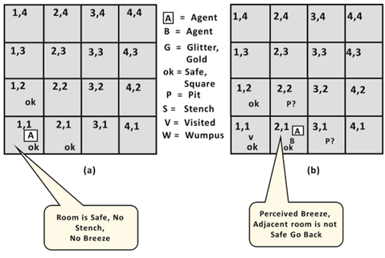
Exploring the Wumpus world:
Now we will explore the Wumpus world and will determine how the agent will find its goal by applying logical reasoning.
Agent's First step:
Initially, the agent is in the first room or on the square [1,1], and we already know that this room is safe for the agent, so to represent on the below diagram (a) that room is safe we will add the symbol OK. Symbol A is used to represent the agent, symbol B for the breeze, G for Glitter or gold, V for the visited room, P for pits, and W for Wumpus.
In Room [1,1] agent does not feel any breeze or any Stench which means the adjacent squares are also OK.

Slide 84
Agent's second Step:
Now agent needs to move forward, so it will either move to [1, 2], or [2,1]. Let's suppose the agent moves to the room [2, 1], at this room agent perceives some breeze which means Pit is around this room. The pit can be in [3, 1], or [2,2], so we will add the symbol P? to say that, is this Pit room?
Now agent will stop and think and will not make any harmful moves. The agent will go back to the [1, 1] room. The room [1,1], and [2,1] are visited by the agent, so we will use the symbol V to represent the visited squares.

Slide 85
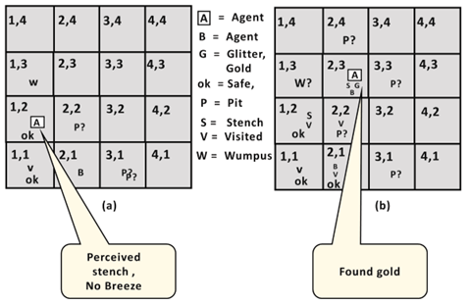
Agent's third step:
In the third step, now agent will move to room [1,2] which is OK. In the room [1,2] agent perceives a stench which means there must be a Wumpus nearby. But Wumpus cannot be in the room [1,1] as by the rules of the game, and not in [2,2] (Agent had not detected any stench when he was at [2,1]). Therefore, the agent infers that Wumpus is in the room [1,3], and in the current state, there is no breeze which means in [2,2] there is no Pit and no Wumpus. So, it is safe, and we will mark it OK, and the agent moves further in [2,2].

Slide 86
Agent's fourth step:
In room [2,2], there is no stench, and no breezes are present so let’s suppose the agent decides to move to [2,3]. In room [2,3] agent perceives glitter, so it should grab the gold and climb out of the cave.

Slide 87
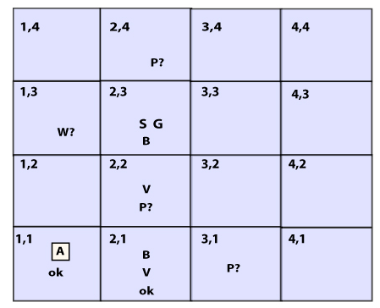
Knowledge-base for Wumpus world
Creating a knowledge base for the Wumpus world and deriving some proves for the Wumpus-world using propositional logic.
The agent starts visiting from the first square [1, 1], and we already know that this room is safe for the agent.
To build a knowledge base for the Wumpus world, we will use some rules and atomic propositions.
We need the symbol [i, j] for each location in the Wumpus world, where i is for the location of rows, and j for column location.

Slide 88
Atomic proposition variable for Wumpus world:
Let P_{i,j} be true if there is a Pit in the room [i, j].
Let B_{i,j} be true if the agent perceives breeze in [i, j], (dead or alive).
Let W_{i,j} be true if there is Wumpus in the square[i, j].
Let S_{i,j} be true if the agent perceives a stench in the square [i, j].
Let V_{i,j} be true if that square[i, j] is visited.
Let G_{i,j} be true if there is gold (and glitter) in the square [i, j].
Let OK_{i,j} be true if the room is safe.
Note: For a 4 * 4 square board, there will be 7*4*4 =122 propositional variables.

Slide 89
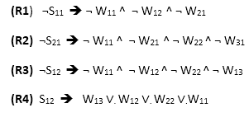
Some Propositional Rules for the Wumpus World:

Slide 90
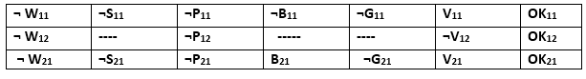
Representation of Knowledgebase for Wumpus world:
Following is the Simple KB for Wumpus world when an agent moves from room [1, 1], to room [2,1]:
Here in the first row, we have mentioned propositional variables for room[1,1], which shows that the room does not have Wumpus(¬ W₁₁), no stench (¬S₁₁), no Pit(¬P₁₁), no breeze(¬B₁₁), no gold (¬G₁₁), visited (V₁₁), and the room is Safe(OK₁₁).
In the second row, we have mentioned propositional variables for room [1,2], which shows that there is no Wumpus, stench, and breeze are unknown as an agent has not visited room [1,2], no pit yet, and the room is safe.
In the third row we have mentioned the propositional variable for room[2,1], which shows that there is no Wumpus(¬ W21), no stench (¬S₂₁), no Pit (¬P₂₁), Perceives breeze(B₂₁), no glitter(¬G₂₁), visited (V₂₁), and the room is safe (OK₂₁).

Slide 91
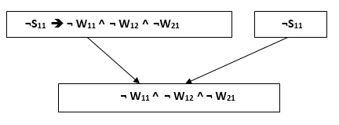
Prove that Wumpus is in the room (1, 3)
We can prove that the Wumpus is in the room (1, 3) using propositional rules which we have derived for the Wumpus world and using inference rule.
Apply Modus Ponens with ¬S11 and R1:
We will firstly apply MP rule with R1 which is ¬S₁₁ → ¬ W₁₁ ^ ¬ W₁₂ ^ ¬ W₂₁, and ¬S₁₁ which will give the output ¬ W₁₁ ^ W₁₂ ^ W₁₂.

Slide 92
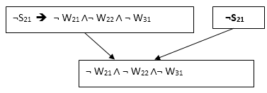
Apply And-Elimination Rule:
After applying And-elimination rule to ¬ W₁₁ ∧ ¬ W₁₂ ∧ ¬ W₂₁, we will get three statements: ¬ W₁₁, ¬ W₁₂, and ¬W₂₁.
Apply Modus Ponens to ¬S₂₁, and R2:
Now we will apply Modus Ponens to ¬S₂₁ and R2 which is ¬S₂₁ → ¬ W₂₁ ∧¬ W₂₂ ∧ ¬ W₃₁, which will give the Output as ¬ W₂₁ ∧ ¬ W₂₂ ∧¬ W₃₁

Slide 93
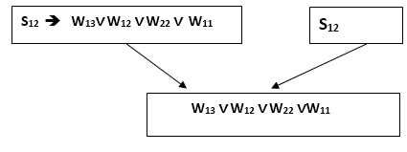
Apply And -Elimination rule:
Now again apply And-elimination rule to ¬ W₂₁ ∧ ¬ W₂₂ ∧¬ W₃₁, We will get three statements: ¬ W₂₁, ¬ W₂₂, and ¬ W₃₁.
Apply MP to S₁₂ and R4:
Apply Modus Ponens to S₁₂ and R₄ which is S₁₂ → W₁₃ ∨. W₁₂ ∨. W₂₂ ∨.W₁₁, we will get the output as W₁₃∨ W₁₂ ∨ W₂₂ ∨.W₁₁.
Apply Unit resolution on W₁₃ ∨ W₁₂ ∨ W₂₂ ∨W₁₁ and ¬ W₁₁ :
After applying the Unit resolution formula on W₁₃ ∨ W₁₂ ∨ W₂₂ ∨W₁₁ and ¬ W₁₁ we will get W₁₃ ∨ W₁₂ ∨ W₂₂.

Slide 94
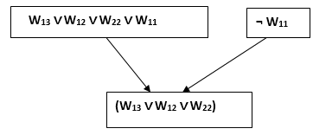
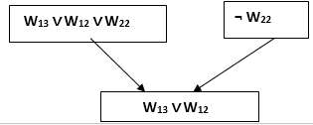
Apply Unit resolution on W₁₃ ∨ W₁₂ ∨ W₂₂ and ¬ W₂₂ :
After applying Unit resolution on W₁₃ ∨ W₁₂ ∨ W₂₂, and ¬W₂₂, we will get W₁₃ ∨ W₁₂ as output.

Slide 95
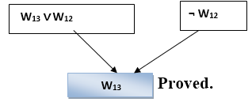
Apply Unit Resolution on W₁₃ ∨ W₁₂ and ¬ W₁₂ :
After Applying Unit resolution on W₁₃ ∨ W₁₂ and ¬ W₁₂, we will get W₁₃ as an output, hence it is proved that the Wumpus is in the room [1, 3].

Slide 99
Resolution method in AI
Resolution method is an inference rule that is used in both Propositional as well as First-order Predicate Logic in different ways. This method is basically used for proving the satisfiability of a sentence. In the resolution method, we use the Proof by Refutation technique to prove the given statement.
The key idea for the resolution method is to use the knowledge base and negated goal to obtain null clause (which indicates contradiction). The resolution method is also called Proof by Refutation. Since the knowledge base itself is consistent, the contradiction must be introduced by a negated goal. As a result, we have to conclude that the original goal is true.
Resolution Method in Propositional Logic
In propositional logic, the resolution method is the only inference rule which gives a new clause when two or more clauses are coupled together.
Using propositional resolution, it becomes easy to make a theorem prover sound and complete for all.
The process followed to convert the propositional logic into a resolution method contains the following steps:
Convert the given axiom into clausal form, i.e., disjunction form.
Apply and prove the given goal using the negation rule.
Use those literals which are needed to prove.
Solve the clauses together and achieve the goal.

Slide 100
Conjunctive Normal Form (CNF)
In propositional logic, the resolution method is applied only to those clauses which are disjunctions of literals. There are the following steps used to convert into CNF:
1) Eliminate bi-conditional implication by replacing A ? B with (A ? B) ? (B ?A)
2) Eliminate implication by replacing A ? B with ¬A V B.
3) In CNF, negation(¬) appears only in literals, therefore we move it inwards as:
¬ ( ¬A) ? A (double-negation elimination
¬ (A ? B) ? ( ¬A V ¬B) (De Morgan)
¬(A V B) ? ( ¬A ? ¬B) (De Morgan)
Finally, using distributive law on the sentences, and form the CNF as:
(A1 V B1) ? (A2 V B2) ? …. ? (An V Bn).
Note: CNF can also be described as AND of ORS

Slide 101
Disjunctive Normal Form (DNF)
This is a reverse approach of CNF. The process is like CNF with the following difference:
(A1? B1) V (A2 ? B2) V…V (An ? Bn).
In DNF, it is OR of ANDS, a sum of products, or a cluster concept, whereas, in CNF, it is ANDs of Ors.
Example OF Propositional Resolution
Consider the following Knowledge Base:
The humidity is high, or the sky is cloudy.
If the sky is cloudy, then it will rain.
If the humidity is high, then it is hot.
It is not hot.
Goal: It will rain.
Use propositional logic and apply the resolution method to prove that the goal is derivable from the given knowledge base.

Slide 102
Solution: Let’s construct propositions of the given sentences one by one:
Let, P: Humidity is high.
Q: Sky is cloudy.
It will be represented as P V Q.
2) Q: Sky is cloudy. …from(1)
Let, R: It will rain.
It will be represented as b Q ? R.
3) P: Humidity is high. …from(1)
Let, S: It is hot.
It will be represented as P ? S.
4) ¬S: It is not hot.

Slide 103
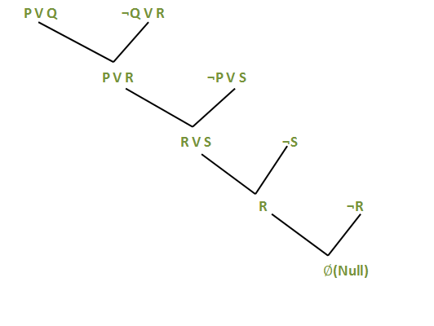
Applying resolution method:
In (2), Q ? R will be converted as (¬Q V R)
In (3), P ? S will be converted as (¬P V S)
Negation of Goal (¬R): It will not rain.
After applying Proof by Refutation (Contradiction) to the goal, the problem is solved, and it is terminated with a Null clause ( Ø ). Hence, the goal is achieved. Thus, It is not raining.

Slide 107
First-Order Logic in Artificial intelligence
In the topic of Propositional logic, we have seen how to represent statements using propositional logic. Unfortunately, in propositional logic, we can only represent the facts, which are either true or false.
PL is not sufficient to represent complex sentences or natural language statements. The propositional logic has very limited expressive power.
Consider the following sentence, which we cannot represent using PL logic.
"Some humans are intelligent", or
"Sachin likes cricket.“
To represent the above statements, PL logic is not sufficient, so we required some more powerful logic, such as first-order logic.

Slide 108
First-Order logic
First-order logic is another way of knowledge representation in artificial intelligence.
It is an extension of propositional logic.
FOL is sufficiently expressive to represent the natural language statements in a concise way.
First-order logic is also known as Predicate logic or First-order predicate logic. First-order logic is a powerful language that develops information about objects in an easier way and can also express the relationship between those objects.
First-order logic (like natural language) does not only assume that the world contains facts like propositional logic but also assumes the following things in the world:
Objects: A, B, people, numbers, colors, wars, theories, squares, pits, Wumpus, ......
Relations: It can be unary relation such as red, round, is adjacent, or n-any relation such as the sister of, brother of,
has color, comes between
Function: Father of, best friend, third inning of, end of, ......
As a natural language, first-order logic also has two main parts:
Syntax
Semantics

Slide 109
Syntax of First-Order logic
The syntax of FOL determines which collection of symbols is a logical expression in first-order logic. T
The basic syntactic elements of first-order logic are symbols. We write statements in short-hand notation in FOL.
Basic Elements of First-order logic
The fundamental components of first-order logic.

Slide 110
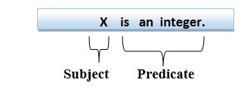
Atomic sentences
Atomic sentences are the most basic sentences of first-order logic. These sentences are formed from a predicate symbol followed by a parenthesis with a sequence of terms.
We can represent atomic sentences as Predicate (term1, term2, ......, term n).
Example: Ravi and Ajay are brothers: => Brothers(Ravi, Ajay).
Chinky is a cat: => cat (Chinky).
Complex Sentences
Complex sentences are made by combining atomic sentences using connectives.
First-order logic statements can be divided into two parts:
Subject: Subject is the main part of the statement.
Predicate: A predicate can be defined as a relation, which binds two atoms together in a statement.
Consider the statement: "x is an integer.", It consists of two parts, the first part x is the subject of the statement, and the second part "is an integer," is known as a predicate.

Slide 111
Quantifiers in First-order logic
A quantifier is a language element that generates quantification, and quantification specifies the quantity of specimen in the universe of discourse.
These are the symbols that permit to determination or identification of the range and scope of the variable in the logical expression. There are two types of quantifiers:
Universal Quantifier, (for all, everyone, everything)
Existential quantifier, (for some, at least one).
Universal Quantifier
A universal quantifier is a symbol of logical representation, which specifies that the statement within its range is true for everything or every instance of a particular thing.
The Universal quantifier is represented by a symbol ∀, which resembles an inverted A.
NOTE: In universal quantifier we use implication "→"

Slide 112
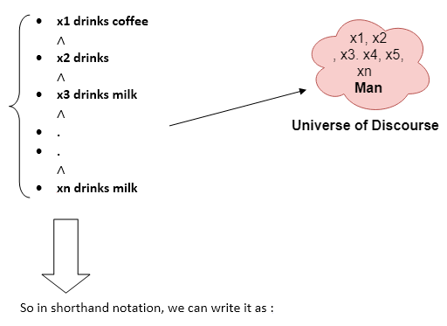
If x is a variable, then ∀x is read as:
For all x
For each x
For every x.
Example:
All men drink coffee.
Let a variable x which refers to a man so all x can be represented in UOD as below:
∀x man(x) → drink (x, coffee).
It will be read as There are all x where x is a man who drinks coffee.

Slide 113
Existential Quantifier
Existential quantifiers are the type of quantifiers, which express that the statement within its scope is true for at least one instance of something.
It is denoted by the logical operator ∃, which resembles an inverted E.
When it is used with a predicate variable then it is called an existential quantifier.
Note: In Existential quantifiers we always use AND or Conjunction symbol (∧).It is read as:
There exists a 'x.'
For some 'x.'
For at least one 'x.'

Slide 114
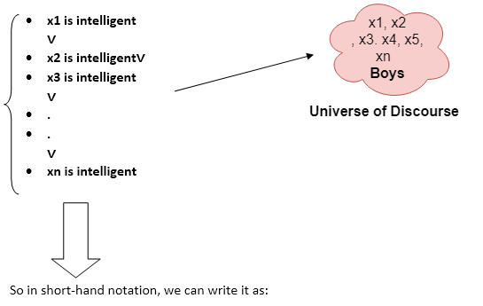
∃x: boys(x) ∧ intelligent(x)
It will be read as There are some x where x is a boy who is intelligent.

Slide 115
Points to remember:
The main connective for universal quantifier ∀ is implication →.
The main connective for existential quantifier ∃ is and ∧.
Properties of Quantifiers:
In the universal quantifier, ∀x∀y is like ∀y∀x.
In the Existential quantifier, ∃x∃y is like ∃y∃x.
∃x∀y is not like ∀y∃x.
Some Examples of FOL using quantifier:
1. All birds fly.
In this question, the predicate is "fly(bird)."
And since there are all birds who fly so it will be represented as follows.
∀x bird(x) →fly(x).

Slide 116
Every man respects his parent.
In this question, the predicate is "respect(x, y)," where x=man, and y= parent.
Since there is every man will use it ∀, and it will be represented as follows:
∀x man(x) → respects (x, parent).
3. Some boys play cricket.
In this question, the predicate is "play(x, y)," where x= boys, and y= game. Since there are some boys, we will use ∃, and it will be represented as:
∃x boys(x) → play(x, cricket).
4. Not all students like both Mathematics and Science.
In this question, the predicate is "like(x, y)," where x= student, and y= subject.
Since there are not all students, we will use ∀ with negation, the following representation for this:
¬∀ (x) [ student(x) → like(x, Mathematics) ∧ like(x, Science)].

Slide 118
USING PREDICATE LOGIC
First-order Predicate logic (FOPL) models the world in terms of
Objects, which are things with individual identities
Properties of objects that distinguish them from other objects
Relations that hold among sets of objects
Functions, which are a subset of relations where there is only one “value” for any given “input”
First-order Predicate logic (FOPL) provides:
Constants: a, b, dog33. Name a specific object.
Variables: X, Y. Refer to an object without naming it.
Functions: Mapping from objects to objects.
Terms: Refer to objects
Atomic Sentences: Atomic sentences are the most basic sentences of first-order logic. These sentences are formed from a predicate symbol followed by a parenthesis with a sequence of terms.
We can represent atomic sentences as Predicate (term1, term2, ......, term n).
A well-formed formula (wff) is a sentence containing no “free” variables. So, That is, all variables are “bound” by universal or existential quantifiers. (∀x)P(x, y) has x bound as a universally quantified variable, but y is free.

Slide 119
Quantifiers
Universal quantification
(∀x)P(x) means that P holds for all values of x in the domain associated with that variable.
E.g., (∀x) dolphin(x) → mammal(x)
Existential quantification
(∃ x)P(x) means that P holds for some value of x in the domain associated with that variable.
E.g., (∃ x) mammal(x) ∧ lays-eggs(x)

Slide 120
Representing Instance and ISA Relationships

Slide 121
Computable Functions and Predicates
To express simple facts, such as the following greater-than and less-than relationships:
gt(1,0) It(0,1) gt(2,1) It(1,2) gt(3,2) It( 2,3)
It is often also useful to have computable functions as well as computable predicates. Thus, we might want to be able to evaluate the truth of gt(2 + 3,1)
To do so requires that we first compute the value of the plus function given the arguments 2 and 3, and then send the arguments 5 and 1 to gt.
It may be necessary to compute functions as part of a fact. In these cases, a computable predicate is used.
A computable predicate may include computable functions such as +, -, *, etc.
For example, gt(x-y,10) →bigger(x) contains the computable predicate gt which performs the greater than function.
Note that this computable predicate uses the computable function subtraction.

Slide 122
Example: Consider the following statements:
1. Marcus was a man.
2. Marcus was Pompeian.
3. Marcus was born in 40 A.D.
4. All men are mortal.
5. All Pompeians died when the volcano erupted in 79 A.D.
6. No mortal lives longer than 150 years.
7. It is now 1991.
8. Alive means not dead.
9. If someone dies, he is dead at all later times.
The wffs for these facts are:
1. man(Marcus)
2. Pompeian(Marcus)
3. born(Marcus,40)
4. ∀x: man(x) → mortal(x)
5. erupted(volcano,79) /\ ∀x: Pompeian(x) → died(x,79)
6. ∀x ∀t1 ∀t2: mortal(x) /\ born(x,t1) /\ gt(t2-t1,150) → dead(x,t2)
7. now=1991
8. ∀x ∀t: [alive(x,t) → ~dead(x,t)] /\ [~dead(x,t) →alive(x,t)]
9. ∀x ∀t1 ∀t2:died(x,t1) /\ gt(t2,t1) →dead(x,t2)

Slide 123
Suppose we want to answer the question “Is Marcus alive now?”.
We can do this by either proving alive(Marcus,now) or ~alive(Marcus,now).
Let us try the latter:
~alive(Marcus,now)
↓ 8
~[~dead(Marcus,now)]
↓ negation operation
dead(Marcus,now)
↓ 9
died(Marcus,t1) /\ gt(now,t1)
↓ 5
erupted(volcano,79) /\ Pompeian(Marcus) /\ gt(now,79)
↓fact, 2
gt(now,79)
↓
gt(1991,79)
↓ compute gt
nil

Slide 124
Resolution
Resolution proves facts and answers queries by refutation. This involves assuming the fact/query is untrue and reaching a contradiction which indicates that the opposite must be true.
The wffs must first be converted to clause form before using resolution.
Algorithm: Converting wffs to Clause Form
1. Remove all implies, i.e., → by applying the following: a → b is equivalent to ~a \/ b.
2. Use the following rules to reduce the scope of each negation operator to a single term:
• ~(~a) = a
• ~(a /\ b) = ~a \/ ~b
• ~(a \/ b) = ~a /\ ~b
• ~∀x: p(x) = ∃x: ~p(x)
• ~∃x: p(x) = ∀x: ~p(x)
3. Each quantifier must be linked to a unique variable. For example, consider
∀x: p(x) \/ ∀x: q(x).
In this, both quantifiers use the same variable, and one must be changed to another
variable: ∀x: p(x) \/ ∀y: q(y).
4. Move all quantifiers, in order, to the left of each wff.

Slide 125
5. Remove existential quantifiers by using Skolem constants or functions.
For example, ∃x: p(x) becomes p(s1), and ∀x ∃y: q(x,y) is replaced with ∀x: q(s2(x), x).
6. Drop the quantifier prefix.
7. Apply the associative property of disjunctions: a \/ (b \/ c) = (a \/ b) \/ c and remove brackets giving a \/ b \/ c.
8. Remove all disjunctions of conjunctions from predicates, i.e., create conjunctions of disjunctions instead, by applying the following rule iteratively: (a /\ b) \/ c = (a \/ c) /\ (b \/ c).
9. Create a separate clause for each conjunction.
10. Rename variables in the clauses resulting from step 9. to ensure that no two clauses refer to the same variable

Slide 126
Consider the following wffs:
1. man(Marcus)
2. Pompeian(Marcus)
3. ∀x: Pompeian(x) → Roman(x)
4. ruler(Caesar)
5. ∀x: Roman(x) → loyalto(x,Caesar) \/ hate(x,Caesar)
6. ∀x ∃y: loyalto(x,y)
7. ∀x ∀y: person(x) /\ ruler(y) /\ tryassassinate(x,y) → ~loyalto(x,y)
8. tryassassinate(Marcus,Caesar)
9. ∀x: man(x) → person(x)
Converting these to clause form gives:
1. man(Marcus)
2. Pompeian(Marcus)
3. ~Pompeian(x) \/ Roman(x)
4. ruler(Caesar)
5. ~Roman(x1) \/ loyalto(x1,Caesar) \/ hate(x1,Caesar)
6. loyalto(x2,s1(x2))
7. ~person(x3) \/ ~ruler(y) \/ ~tryassassinate(x3,y) \/ ~loyalto(x3,y)
8. tryassassinate(Marcus, Caesar)
9. ~man(x4) \/ person(x4)

Slide 127
Suppose that we want to prove that Marcus hates Caesar
We first convert this to a wff: hate(Marcus, Caesar).
The wff is then negated and converted to clause form:
Thus, we have a contradiction and the original statement, i.e., Marcus hates Caesar must be true.

Slide 128
Consider the wffs we created above:
1. man(Marcus)
2. Pompeian(Marcus)
3. born(Marcus,40)
4. ∀x: man(x) → mortal(x)
5. erupted(volcano,79) /\ ∀x: Pompeian(x) → died(x,79)
6. ∀x ∀t1 ∀t2: mortal(x) /\ born(x,t1) /\ gt(t2-t1,150) → dead(x,t2)
7. now=1991
8. ∀x ∀t: [alive(x,t) → ~dead(x,t)] /\ [~dead(x,t) →alive(x,t)]
9. ∀x ∀t1 ∀t2:died(x,t1) /\ gt(t2,t1) →dead(x,t2)
Suppose we now want to use the resolution to prove that “Marcus is not alive now”. We first must convert these statements to clause form:
1. man(Marcus)
2. Pompeian(Marcus)
3. born(Marcus,40)
4. ~man(x) \/ mortal(x)
5. erupted(volcano,79)
6. ~Pompeian(x1) \/ died(x1,79)
7. ~mortal(x2) \/ ~born(x2,t1) \/ ~gt(t2-t1,150) \/ dead(x2,t2)
8. now=1991
9. ~alive(x3,t) \/ ~dead(x3,t)
10. dead(x4,t3) \/ alive(x4,t3) 11. ~died(x5,t4) \/ ~gt(t5,t4) \/ dead(x5,t5)

Slide 129
We want to prove ~alive(Marcus, now).
We negate this and convert it into clause form: alive(Marcus, now) and find a contradiction:

Slide 130
1. Consider the following facts:
1. John likes all kinds of food.
2. Apples are food.
3. Chicken is food
4. Anything anyone eats and is not killed by is food.
5. Bill eats peanuts and is still alive.
6. Sue eats everything Bill eats.
a) convert the wffs for these facts to clause form.
b) Using resolution to prove that “John likes peanuts”.
2. Consider the following facts:
1. Steve only likes easy courses.
2. Science courses are hard.
3. All the courses in the basketweaving department are easy.
4. BK301 is a basket weaving course.
a) Convert the wffs for these facts to clause form.
b) Use resolution to answer the question “What course would Steve like?”.

Slide 131
The Unification Algorithm
In propositional logic, it is easy to determine that two literals cannot both be true at the same time.
• Simply look for L and ¬L in predicate logic, this matching process is more complicated since the arguments of the predicates must be considered.
• For example, man(John) and ¬man(John) is a contradiction, while the man(John) and ¬man(Spot) is not.
• Thus, to determine contradictions, we need a matching procedure that compares two literals and discovers whether there exists a set of substitutions that makes them identical.
• There is a straightforward recursive procedure, called the unification algorithm, that does it.

Slide 134
Natural Deduction Using Rules

